Slide 1
Smart LookUP We give you the insights, You build the story !
Manikanta Reddy, Pranshu Gupta, Sumit Kalra

Slide 2
Introduction
Smart LookUP provides you with a new way to interact with your content.
It generates relevant information about the content you are viewing within Google Chrome, easing your researching tasks.

Slide 3
Demo

Slide 4
Architecture
Smart LookUP has four
major components
Content Reader
Topic Identifier
Insight Collector
User Interface

Slide 5
Architecture
Content Reader: Reads the content of the selected text from the current webpage
Topic Identifier: Identifies the domain or topic from the content with the help of Machine Learning APIs.
Insight Collector: Fetches the relevant content available over the internet.
User Interface: Intiutive GUI component of the Smart LookUP extension.

Slide 6
Key Features
Extensible
Easy to add new features
Ease of Use
No manual Required, even for a novice user
Platform Independent
Can run on various devices with ease.
Ease of Installation
Availability on the Chrome Web Store.
Modular Design
Easy to maintain and Update

Slide 7
Business Plan Everyone of us is different !
Smart LookUP :
Helps in designing quality content in real time
Target Audience:
Writers, Researchers, Media Industry, Content Creators, Business Analysts, Market Watchers, …

Slide 8
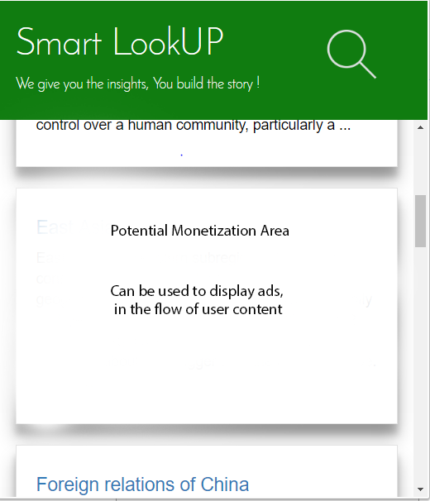
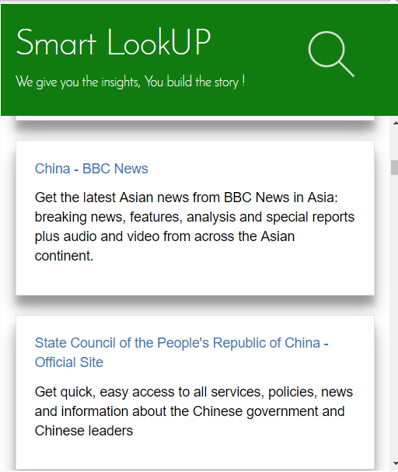
Business Plan Monetization (free version)
Cards can be used to show ads that can be monetized easily.
We can charge services, so that their results appear higher in the search.

Slide 9
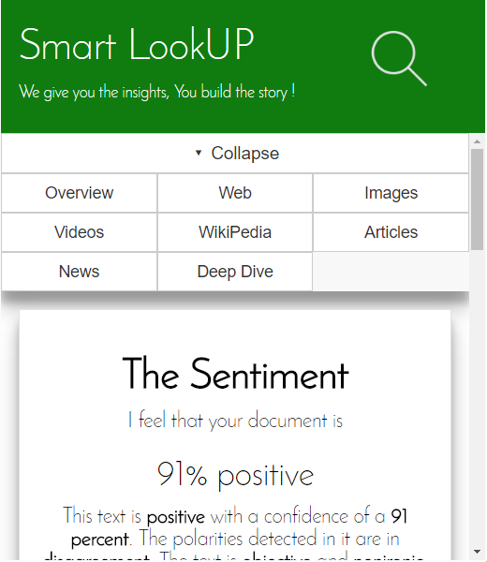
Business Plan Monetization (paid version)
3rd party service integrations: More services can be added to extend the plugin
Customized Smart LookUP: Based on users domain of interest.
Example: Someone in academia, can opt to choose google scholar search, while a different person in stock markets might be only interested in real time stock news.

Slide 10
Business Plan: Cost Effectiveness Monetization (paid version)
Individual 3rd party services are expensive
We reduce this overhead by distributing the cost over multiple subscribed users.
Pay-as-you-go: Charge the User only for the services they use

Slide 11
THANK YOU

